Slide 1
Biomolecules
Biology Bonanza

Slide 2
Biomolecules are organic molecules produced by living organisms. What are the structure and function of the 4 classes of biomolecules?
Carbohydrates
Lipids
Proteins
Nucleic Acids
The term “organic” means the molecule contains which element?
Carbon

Slide 3
Which of these biomolecules is produced during photosynthesis and used as an energy source in cellular respiration?
Glucose (carbohydrate)
What are the differences between monomers and polymers?
Monomers are small molecules.
Polymers are large molecule made up of monomers

Slide 4
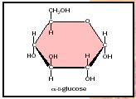
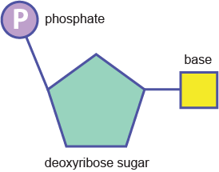
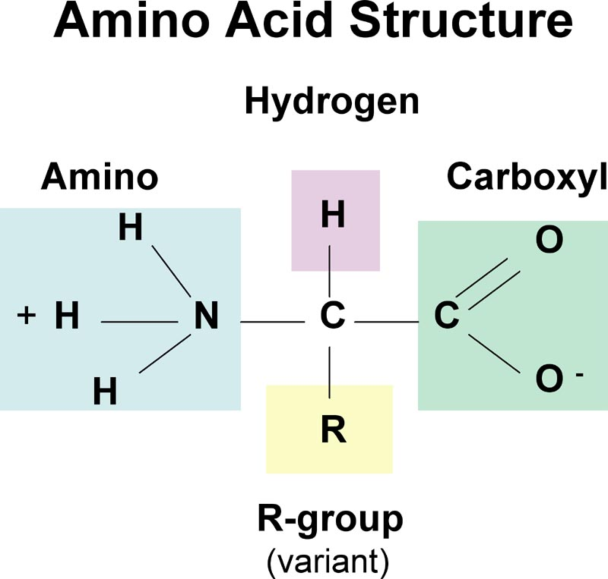
Which biomolecule is represented by each of the monomers below?

Slide 5
What is the name of the process that uses monomers to build polymers?
Dehydration synthesis
What is the name of the process that breaks down polymers?
Hydrolysis

Slide 6
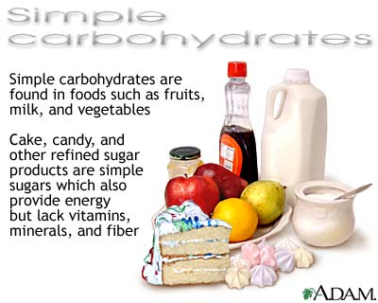
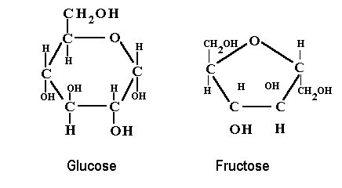
Carbohydrates
Provides energy for cellular processes
Short-term energy
Made up of C,H,O
H and O in a 2:1 ratio
Ex: glucose, starch and cellulose

Slide 7
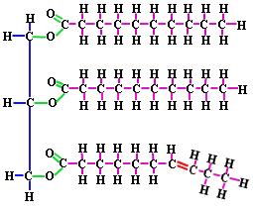
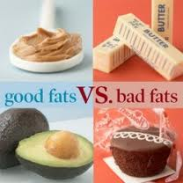
Lipid
Long term energy storage
Building blocks of membranes
Makes waterproof coverings
Made up of C,H,O – ratio between H and O is much greater than 2:1
Components are fatty acids
and glycerol
Ex. Fats, oils, waxes

Slide 8
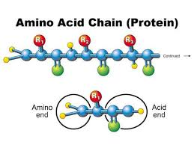
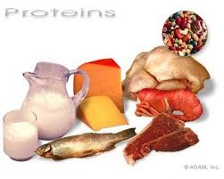
Proteins
Controls reaction rate by lowering activation energy (enzymes)
Forms muscles and provides structure
Transports materials thru cell membrane
Made up of amino acids; C,H,O,N
Ex. Enzymes, hormones, antibodies

Slide 9
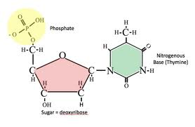
Nucleic Acids
Stores and transmits hereditary information
Made up of nucleotides and the elements C,H,O,N,P
Ex. DNA and RNA

Slide 10
Fill in the Macromolecule chart and answer the questions
Types and Examples | Monomers and Polymers | Elements | Structure/Function
Carbohydrate glucose (sugar) starch | M-monosaccharide P-polysaccharide | C, H, O | Provides most of the energy for cell processes H and O in a 2:1 ratio
Lipid fats oils | Fatty acids and glycerol | C, H, O | Building block of biological membranes, makes coverings waterproof, long term energy storage
Protein enzymes hormones | M-amino acids P-polypeptide (protein) | C, H, O, N | Controls rates of reactions, regulates cell processes, forms bones and muscles, transports materials in and out of cells, fights diseases
Nucleic acid DNA RNA | M-nucleotide P-DNA, RNA | C, H, O, N, P | Stores and transmits hereditary information

Slide 11
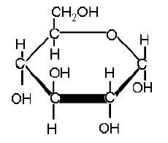
1. The diagram below represents which of the following biomolecules?
a. carbohydrate
b. protein
c. lipid
d. nucleic acid

Slide 12
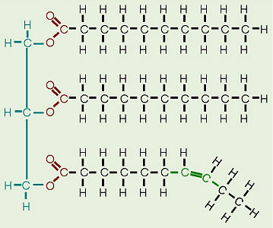
2. The diagram below represents which of the following biomolecules?
a. carbohydrate
b. protein
c. lipid
d. nucleic acid

Slide 13
3. Nitrogen is NOT a part of which of these biomolecules?
a. enzyme
b. amino acid
c. nucleic acid
d. carbohydrates

Slide 14
4. Why is nitrogen important to living things?
a. Nitrogen is a key component of all carbohydrates.
b. Nitrogen is a key component of proteins.
c. Nitrogen is a key component of cellulose.
d. Nitrogen is a key component of lipids.

Slide 15
5. Which of these important chemicals forms the framework for carbohydrates, fats, and other molecules of life?
a. nitrogen
b. oxygen
c. water
d. carbon

Slide 16
6. Identify the molecule, which is broken down during respiration forming water and carbon dioxide and releasing energy.
a. deoxyribonucleic acid (DNA)
b. glucose
c. nicotinamide adenine dinucleotide (NAD+)
d. hemoglobin

Slide 17
7. which of the following pairs is incorrect?
a. RNA and nucleic acid
b. enzyme and protein
c. oil and lipid
d. fat and carbohydrate

Slide 18
8. To which group do enzymes belong?
a. lipids
b. proteins
c. carbohydrates
d. nucleic acids

Slide 19
9. biomolecules are crucial to a variety of life processes and body structures. One of these molecules is protein. Which of the following is true of proteins?
a. composed of building blocks called amino acids
b. insoluble in water and are used by the body for energy storage and insulation
c. complex biomolecules that store genetic information
d. organic compounds used by cells to store and release energy

Slide 20
10. To which group do sugars belong?
a. nucleic acids
b. proteins
c. lipids
d. carbohydrates

Slide 21
11. Which of the following statements about enzymes is true?
a. Amylase, a digestive enzyme found in saliva, helps break down food molecules.
b. Enzymes do not play a role in metabolic processes of the body.
c. Enzymes are chemically altered during reactions in which they are involved.
d. Enzymes always slow the rate at which a chemical reaction occurs.

Slide 22
12. Like complex carbohydrates, proteins are biomolecules that serve many functions and can be chemically broken down and restructured. Both proteins and complex carbohydrates are which of the following?
a. polymers of smaller subunits
b. sequences of sugars
c. lipids of large molecules
d. nucleotides of DNA

Slide 23
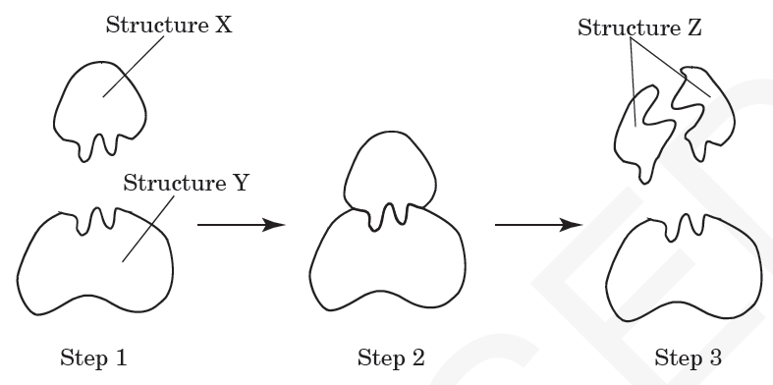
13. This diagram shows an enzyme-substrate complex. Which is represented by Structure X?
a. substrate
b. product
c. enzyme
d. complex

Slide 24
14. What will most likely happen if an appropriate enzyme is added to a chemical reaction?
a. The reaction rate will increase.
b. The equilibrium of the reaction will be maintained.
c. The reaction rate will decrease.
d. The reaction will stop.

Slide 25
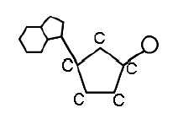
15. The diagram below is the monomer of nucleic acids. What is this monomer?
a. amino acid
b. saccharide
c. 3 fatty acids & glycerol
d. nucleotide

Slide 26
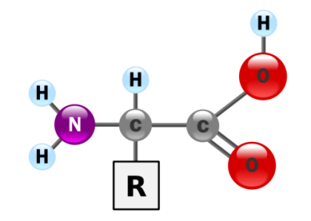
16. The diagram below represents which of the following biomolecules?
a. carbohydrate
b. protein
c. lipid
d. nucleic acid

Slide 27
I Need to Remember…..
Simple sugars, the smallest carbohydrates, serve as fuel.
Lipids store large amounts of energy.
A protein’s function depends on its unique sequence of amino acids.
Nucleic acids store and transmit hereditary information.
Organic molecules contain carbon.
Monomers are smaller subunits that make up polymers.

