Slide 1
Answer the following questions for the picture.
Write the ANSWER only.
2. _______ ________ requires energy to move from low to ______
1. _________ is the movement of water.
3. _________ moves sugar/salt in the direction of _______ to _______ .
4. ________ ________ needs a ______ to move through the membrane.
5. The cell membrane is made up of what three molecules?

Slide 2
Essential Question: What are the 4 methods of cellular transport?

Slide 3
Diffusion
Diffusion - Defined as the movement of particles from areas of high concentration to areas of low concentration (down the concentration gradient)
Particles spread out
Ex: Solute = perfume Solvent = the air
High Solute Concentration
Low Solute Concentration
Notes:
An example of diffusion in the air and also in an agar dish are good to go over here.

Slide 4
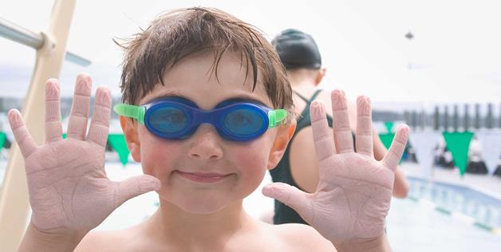
Osmosis
Diffusion that involves water.
Movement of water across a semi-permeable membrane
Water moves from areas of low solute to areas of high solute
Why do your fingers “shrivel–up” when you are in the water?

Slide 5
Facilitated Diffusion
*Is a type of passive transport
Doesn’t require energy
Uses transport proteins to move molecules from high to low concentration
Facilitated Diffusion- is the movement of larger molecules like glucose through the cell membrane → larger molecules must be “helped”
Examples: Glucose or amino acids moving from blood into a cell.

Slide 6
Active Transport
Requires Energy.
ATP (form of energy made by mitochondria).
Moves against the concentration gradient.
This is going to be hard work!!
High
low

Slide 7
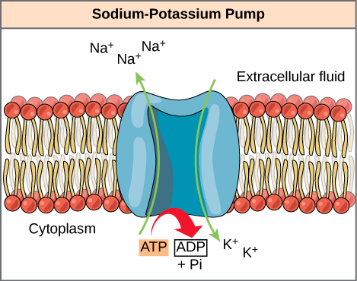
Sodium Potassium Pump
What I need to know
Active transport goes AGAINST the concentration gradient
Low solute concentration to high solute concentration
The cell uses energy (ATP) to actively transport Na⁺ out of the cell and K⁺ into the cell against the concentration gradient
https://www.youtube.com/watch?v=P-imDC1txWw

Slide 8
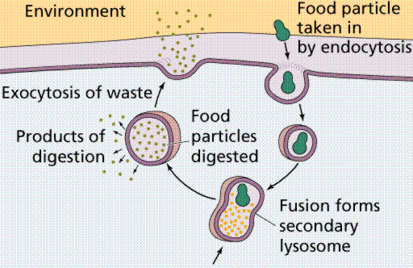
Endocytosis and Exocytosis is the mechanism by which very large molecules (such as food and wastes) get into and out of the cell
**ENERGY IS REQUIRED
Food is moved into the cell by Endocytosis
Wastes are moved out of the cell by Exocytosis

Slide 9
Endocytosis
Transporting material into a cell by the in folding of a membrane.
Think endo-
Think enter
To take inside of the cell

Slide 10
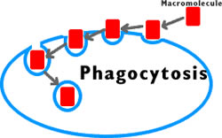
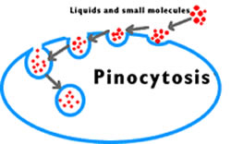
2 Types of Endocytosis
Phagocytosis- Solid particles are ingested into the cell.
Pinocytosis – liquids and very small molecules are taken into the cell.

Slide 11
Endocytosis

Slide 12
Exocytosis
Moves materials out of the cell
Think exo-
Think exit

Slide 13
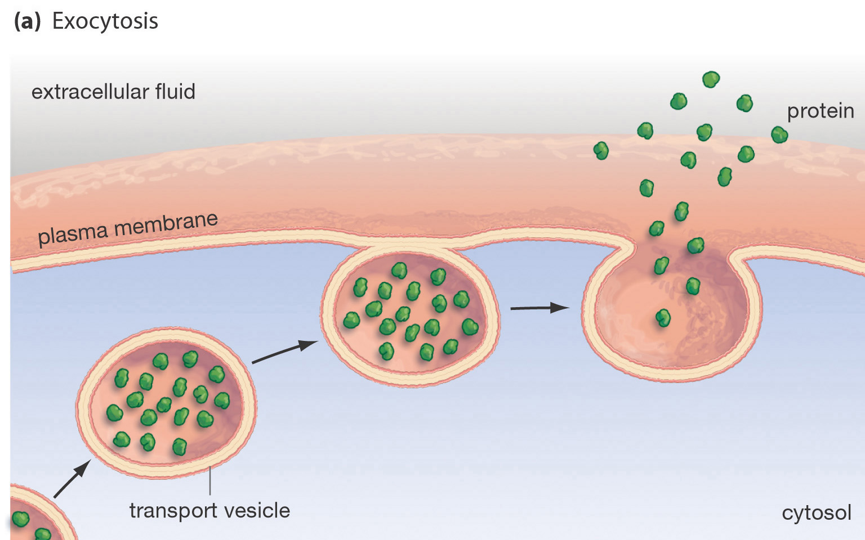
Moving the “Big Stuff”
Exocytosis- moving things out.
Molecules are moved out of the cell by vesicles that fuse with the plasma membrane.
This is how many hormones are secreted and how nerve cells communicate with one another.

Slide 14
Page 19: Molecule Transport Foldable Instructions
With the Cell Membrane facing up, fold your paper in half (Hot Dog Style)
On the half facing up – Separate into 4 Segments and write the Diffusion, Osmosis, Facilitated Diffusion and Active Transport (in that order)
Cut 3 slits on the segments ONLY of the half of the paper facing you.

Slide 15
Molecule Transport Foldable

Slide 16
*What you must include inside and outside of EACH Fold*
Type of transport: Diffusion, Osmosis, Facilitated Diffusion, Active Transport (Draw picture on the outside/write and describe on the inside)
Is the transport passive or active? (Draw picture on the outside/write and describe on the inside)
Does the process require energy (ATP)? (Draw picture on the outside/write and describe on the inside)

Slide 17
*What you must include inside and outside of EACH Fold*
What’s moving during this process? Water OR the solutes? (Draw picture on the outside/write and describe on the inside)
Is it moving from a High to Low solute concentration OR a Low to High solute concentration? (Draw picture on the outside/write and describe on the inside)
Does it move through the Phospholipid Bilayer OR a Protein Channel? (Draw picture on the outside/write and describe on the inside)

Slide 18
On the very back of foldable…
DRAW and DESCRIBE Endocytosis
Include → What type of transport is it? (Active or passive)
How does it work?
DRAW and DESCRIBE Exocytosis
Include → What type of transport is it? (Active or passive)
How does it work?

