Slide 1
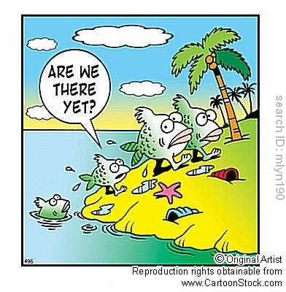
Evolution of Populations

Slide 2
Populations
Recall that natural selection affects populations, not individuals.
A population is defined as a group of organisms of the same species living together in a given area.
Individuals of a population can breed to create fertile offspring, transferring genes from one generation to the next.

Slide 3
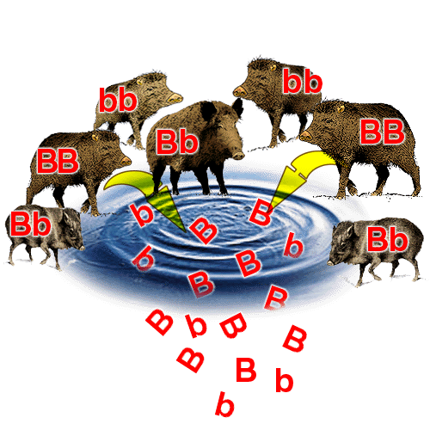
Genes and Variation
All of the alleles for every gene present in a population at any one time are called the population’s gene pool.
Allele frequency—frequency with which a particular gene variant is found in a population

Slide 4
Changes to Gene Pools
New genes or alleles can be introduced into a gene pool through genetic mutations.
If the individual survives to pass on the gene to the next generation, the mutation becomes part of the gene pool.
Natural selection can also change gene pools. Ex. Introduction of a new predator

Slide 5
Genetic Equilibrium
Populations in a state of genetic equilibrium do not change or evolve.
Gene pools are stable.
Allele frequencies are stable.
No increase or decrease in the number of variations in the population.
Natural selection upsets genetic equilibrium and causes changes in populations.

Slide 6
Types of Natural Selection
Directional Selection—a single variation of a trait that was not previously favored is now favored usually due to an environmental change
Stabilizing Selection—extreme variations of a trait are selected against; the average value for a trait is selected for
Diversifying Selection—multiple variations of a trait are favored in a single species

Slide 7
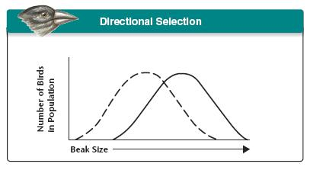
Directional Selection
Directional Selection—a single variation of a trait that was not previously favored is now favored usually due to an environmental change
Ex. Larger body size favored during ice age

Slide 8
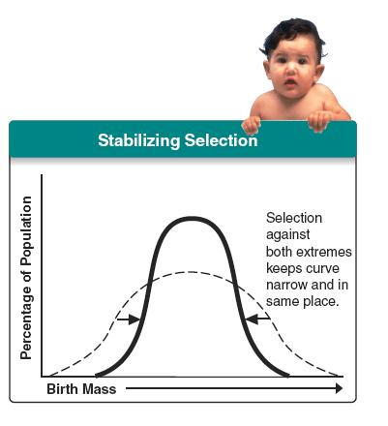
Stabilizing Selection
Stabilizing Selection—extreme variations of a trait are selected against; the average value for a trait is selected for
Ex. All zebras have stripes
Decreases diversity in a species

Slide 9
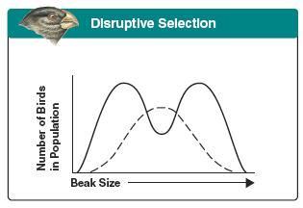
Diversifying Selection
Diversifying Selection—multiple variations of a trait are favored in a single species
Two or more variations are equally beneficial
Ex. Light and dark butterflies have equal opportunities to hide from predators
Increases diversity in a species
Also known as disruptive selection

Slide 10
Adaptive Radiation
Diversifying selection may lead to adaptive radiation
Adaptive Radiation—creation of new species from a species presented with new environmental conditions
Ex. Darwin’s finches in the Galapagos Islands

Slide 11
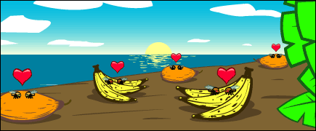
Speciation
Speciation—creation of new species
In order for a new species to evolve, populations must become reproductively isolated from one another.

Slide 12
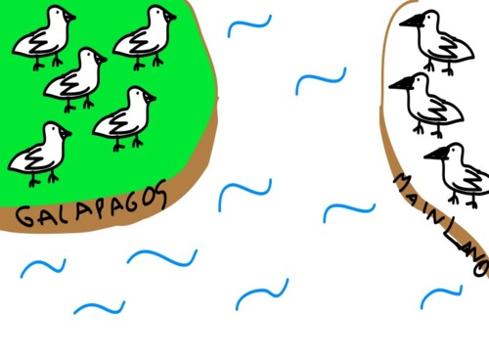
Allopatric Speciation
Allopatric speciation—geographic isolation enables new species to be created
Ex. Construction of a dam creates two separate lakes

Slide 13
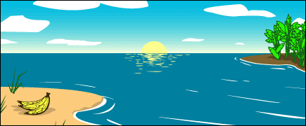
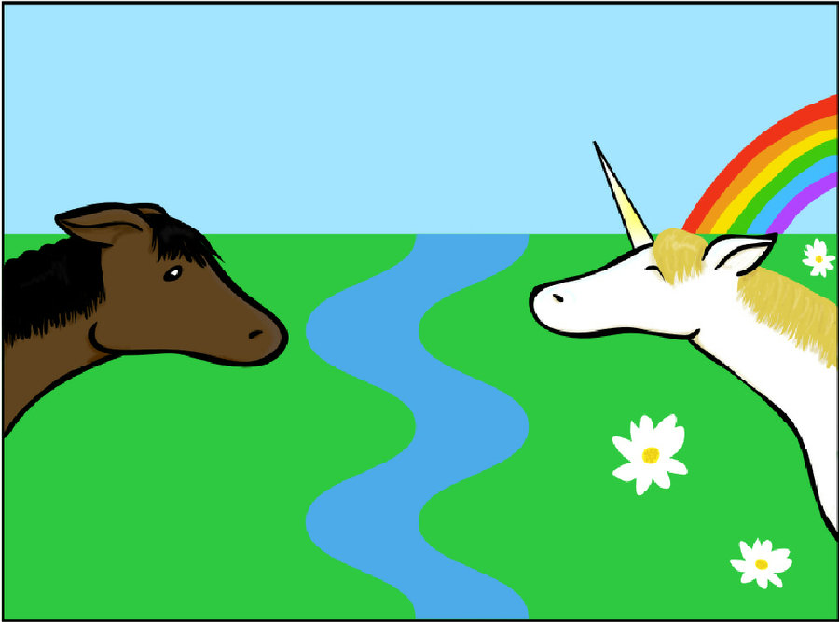
Geographic Isolation
Populations are separated by geographic barriers such as rivers or mountains that keep them apart.

Slide 14
Sympatric Speciation
Sympatric speciation—new species are created without geographic isolation
Ex. New species of fish evolve in the same lake
Behavioral and temporal isolation can lead to sympatric speciation.

Slide 15
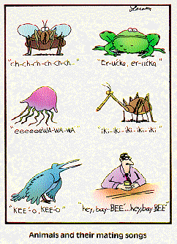
Behavioral Isolation
Two populations are capable of interbreeding but have different behaviors that keep them apart.
Ex. Songs, courtship rituals

Slide 16
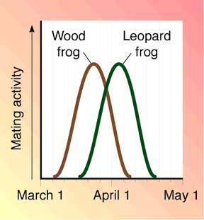
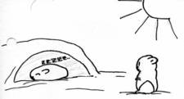
Temporal Isolation
Populations are kept apart because they reproduce in different months, time of day, etc..

Slide 17
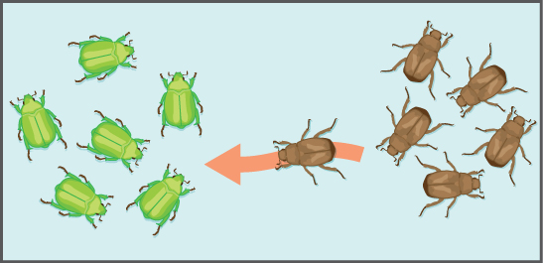
Gene Flow
Gene flow is the transfer of alleles from one population to another, often due to migration
Gene flow introduces new alleles into populations and increases variation. This fuels natural selection and evolution.

Slide 18
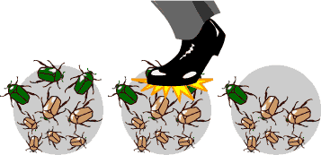
Genetic Drift
Genetic drift is the process by which changes in allele frequencies occur because of random events.
Small populations are affected the most.

Slide 19
Increasing Genetic Drift
Bottleneck Effect—a drastic change in environment such as a natural disaster significantly reduces population size. Survivors may have a very different gene pool than the starting population.
Founder Effect—random group of individuals is separated from the parent population. Again, the gene pool of the new population may be very different from the starting population

Slide 20
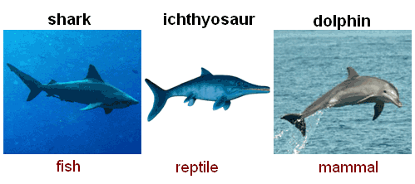
Patterns of Evolution
Convergent Evolution—unrelated organisms evolve similar adaptations usually due to similar environmental conditions

Slide 21
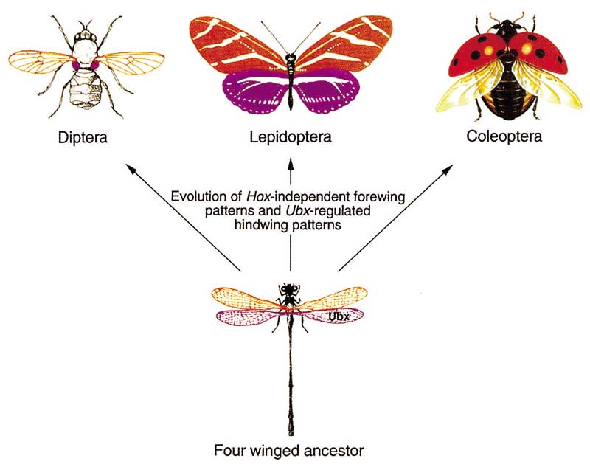
Patterns of Evolution
Divergent Evolution—related species become increasingly different from each other due to different environmental conditions

Slide 22
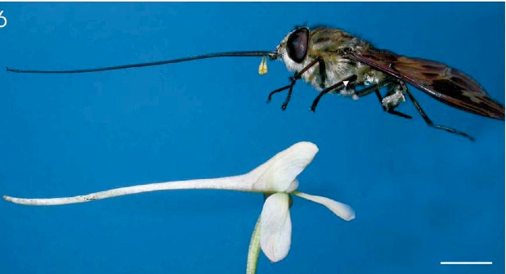
Patterns of Evolution
Coevolution—evolution of one species is a direct result of evolution of another species

Slide 23
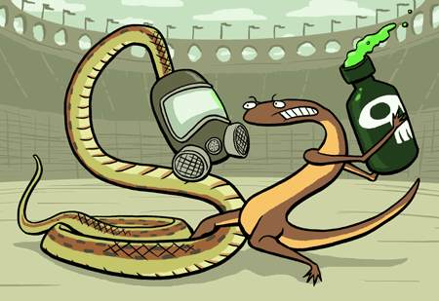
Coevolution
Cooperative—both species benefit and generally evolve to depend on each other further and further
Ex. Hummingbird and flower
Antagonistic—species evolve counter-adaptations against each other
Ex. Snake and poisonous newt

Slide 24
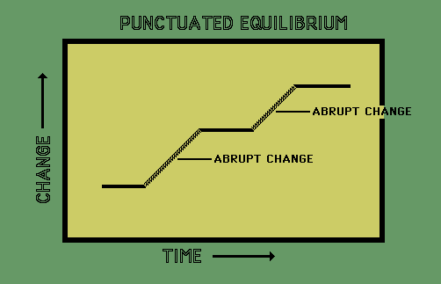
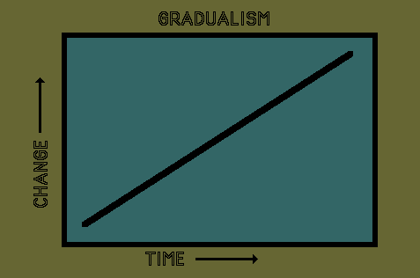
Speed of Speciation
Punctuated Equilibrium—drastic changes create new species then little change occurs
Gradualism—species gradually change over time

