Slide 1
Face Lab
Simple Mendelian Inheritance, Incomplete Dominance, and Polygenic Traits

Slide 2
Rolling for Traits
Each partner/parent will need a coin or access to a coin toss app.
For the first trait, only the “Dad” will roll a coin. Heads will be a boy, tails will be a girl.
For the remaining traits, both parents will roll. Heads will indicate the dominant trait (ex. A,) and tails will indicate the recessive trait (ex. A.)
The child’s genotype is the combination of both parents’ genes (Ex. Aa)

Slide 3
Sex Determination
X
XX
female

Slide 4
Simple Mendelian Inheritance
The traits we have studied so far have been inherited by simple Mendelian inheritance.
Genes are either dominant or recessive.
Dominant covers up recessive.
TWO phenotypes result
Example: #1 Face Shape
RR and Rr both result in a round face
rr will mean a square face

Slide 5
Simple Mendelian Inheritance
R
r
Rr
Round face
Simple Mendelian

Slide 6
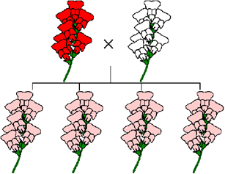
Incomplete Dominance
One allele is not completely dominant over another.
The heterozygous phenotype is somewhere in between the two homozygous phenotypes.

Slide 7
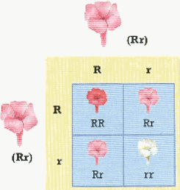

Slide 8
Incomplete Dominance
THREE phenotypes result
Example: #6 Hair Type
CC will have curly hair
Cc will have wavy hair
cc will have straight hair

Slide 9
Incomplete Dominance
c
C
Cc
Wavy hair
Incomplete dominance

Slide 10
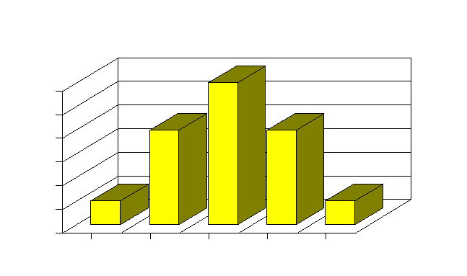
Polygenic Traits
Traits that are produced by the interaction of several genes
A wide variety of phenotypes results
Ex. Skin color and height in humans

Slide 11
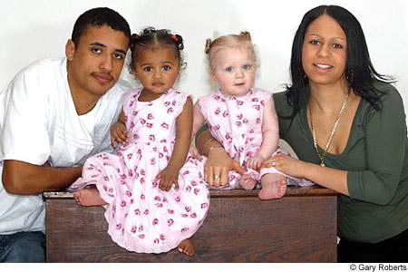

Slide 12
https://www.yahoo.com/parenting/no-one-believes-these-biracial-twins-are-sisters-112610479632.html

Slide 13
Polygenic Traits
Parents will roll more than once
MANY phenotypes will result
Example: #5 Skin Color
Three genes are involved so each parent will roll three times—once for the “A” gene, once for the “B” gene and once for the “C” gene. Record all three in the same space on the chart.
The child will receive six total genes, and each capital letter will add color. AABBCC will be very dark skinned. aabbcc will be very light skinned. AaBbCc will have a medium skin tone. See #5 on the lab for specifics.

Slide 14
Polygenic Traits
aBC
abC
aaBbCC
Medium brown
Polygenic inheritance

Slide 15
#11 Eye Color
Another polygenic trait
Two genes are involved so each parent will roll twice—once for an “A” gene and once for a “B” gene.
The child will receive four total genes.

Slide 16
Polygenic Traits
AB
aB
AaBB
Dark brown eyes
Polygenic inheritance

