Slide 1
Invasive Species CER+R Texas Parks and Wildlife Video

Slide 2
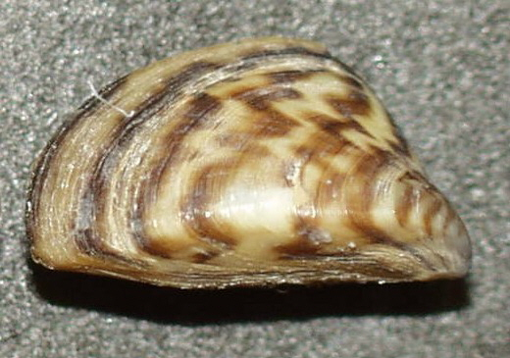
Invasives: Good or Bad?
The effects of invasive species have long been documented as a negative trend on the ecosystems in which they reside. Invasive species often dominate new environments, throwing off the delicate balance of things and eliminating rare or key species. What few people realize is that through the negative window that invasive species are viewed, there are also some positive effects that they can have.

Slide 3
Zebra Mussels
Zebra Mussels are one of these species that have had an unexpected effect on an environment, though what effect they will continue to have is still an unknown. This specific invasive species was identified in Texas lakes in 2009. Zebra mussels filter a liter of water a day and in just a few years time, can increase the clarity of water by 600%. Through this filtration process, this invasive species removes almost all nutrients, which can cause levels to drop by 80%.

Slide 4
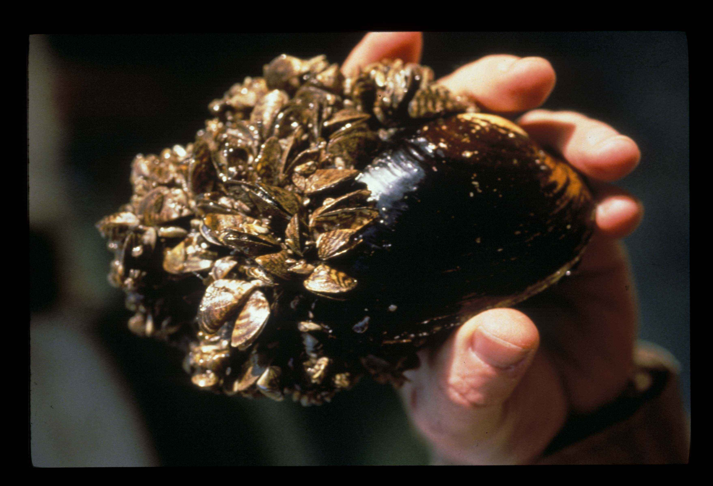
Filter Feeders
Even though Zebra mussels have been given a bad name as an invasive species, there are species of freshwater mussels that are welcomed and needed in the food webs of aquatic ecosystems. Adult freshwater mussels are filter-feeders and consume zooplankton, phytoplankton, diatoms, and other microorganisms in the water column, as well as detritus and bacteria.

Slide 5
Zebra and Unionid Mussels
Unionid mussels, a family of freshwater mussels, are important indicators of water quality and stream health. On the following slide is a graph that provides information about the relationship between native Unionid mussels and Zebra mussels, as well as the effect of zebra mussels on water clarity.

Slide 6
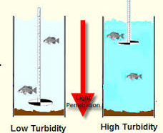
Secchi Depth Measurements
A black and white secchi disk is lowered into a body of water.
When the disk can no longer be seen, the depth of the disk is recorded.
This is a method of determining the clarity of water.

Slide 7
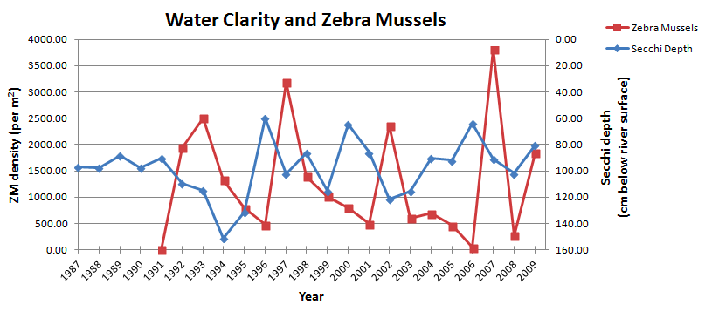

Slide 8
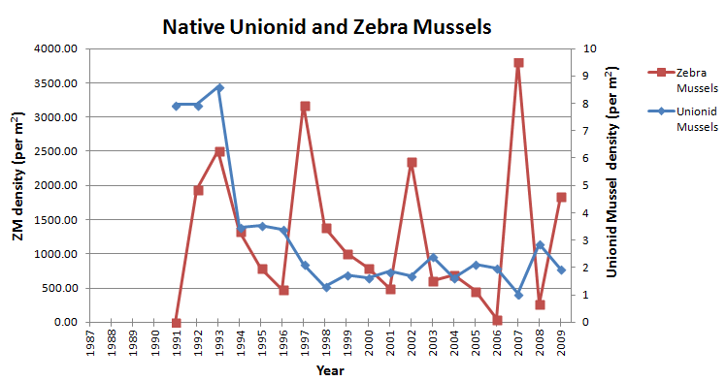

Slide 9
Things to Consider
What are zebra mussels removing from the water which increases the water clarity?
What are the effects of this removal on other aquatic organisms?
What are the benefits of water clarity?
Are unionid mussels an important part of aquatic ecosystems?
What does the second graph tell you about zebra and unionid mussel populations from 1987-2009?

Slide 10
Assignment
Use the CER+R framework to write a scientific explanation explaining the impact of an invasive species on an environment.
Claim: a statement answers the original question/problem (15 points)
How do zebra mussels impact the environment?
Evidence: scientific data that supports the claim (30 points)
Data needs to be appropriate and sufficient
Refer to specific data from the graph.
Reasoning: a justification that connects the evidence to the claim. (30 points)
It shows why the data counts as evidence by using appropriate and sufficient scientific principles
How does the graph data support your position?
Rebuttal: recognizes and describes alternative explanations, and provides counter evidence and reasoning for why the alternative explanation is not appropriate (25 points)
What other points of view might people have? Are they valid and why/why not?
*The CER+R should flow and is written as a paragraph or series of paragraphs, not as separate answers for each part. Except for the claim, each part of the CER+R should contain a minimum of 3 sentences.

