Slide 1
Science Basics
Variables
Hypotheses
Conclusions
Graphing

Slide 2
Investigation One
Rosita found that if she varied the amount of water she gave her plants, the plants grew at different rates.
What one thing was deliberately changed in the investigation?
Amount of water given to each plant
What happened as a result of the change?
Plants grew at different rates

Slide 3
Investigation Two
Five fish were placed in an aquarium and fed appropriate amounts of fish food. Each month, their lengths were measured.
What one thing was deliberately changed in the investigation?
Time
What happened as a result of the change?
Fish grew

Slide 4
Investigation Three
A bowl of popcorn and a bowl of pretzels were placed within the reach of hungry students. Within five minutes, all of the popcorn and half of the pretzels had been eaten.
What one thing was deliberately changed in the investigation?
Choice of popcorn or pretzels
What happened as a result of the change?
Amounts eaten

Slide 5
Independent vs. Dependent Variables
The variable that is deliberately changed is the independent or manipulated variable.
This is what the experimenter does.
It is sometimes called the experimental variable.
On a graph, this variable is found on the x-axis
The variable that changes as a result of the experiment is the dependent or responding variable.
This is the data—observations/information gathered in an experiment.
On a graph, this variable is found on the y-axis.

Slide 6
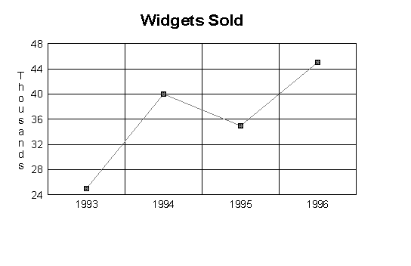
DRY MIX Mnemonic
Dependent
Responding
Y-axis
Manipulated
Independent
X-axis

Slide 7
If………..Then……….
You can also identify independent vs. dependent variables by plugging them into the if….then….statement.
EX: You want to know how the number of snails added to an aquarium changes the levels of nitrates (waste) in the water.
If snails are added to the aquarium (IV)
Then waste levels will rise (DV)
This statement is a hypothesis

Slide 8
The hypothesis must be TESTABLE.
Testable: Observable and Measureable
Inches a plant grows
Amount of food a dog eats
Reaction time
Test scores
Number of offspring produced
Not Testable
Opinions
Emotions of animals
Likes/dislikes of animals
Magic
Unobservable phenonmena

Slide 9
Experimental Design
Only ONE variable is tested at a time in a controlled experiment.
Remaining variables are kept constant.
EX. You want to measure plants’ growth.
Invalid Experiment:
Group One—normal temp, soil, location, water
Group Two—cold temp, bad soil, closet, no water
Valid Experiment
Group One—normal temp, soil, location, water
Group Two—cold temp, normal soil, location, water

Slide 10
Experimental Design
The control group in an experiment is the group kept in normal conditions.
Ex. Students take test in a classroom (control)
Students take test outside (experimental)
A control group allows you to compare the groups receiving treatment with a group receiving no treatment and make valid conclusions.

Slide 11
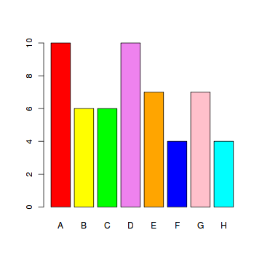
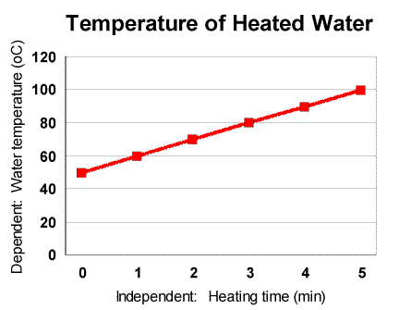
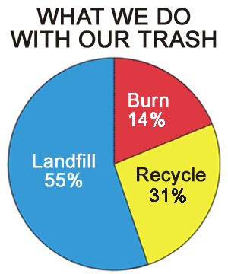
Graphs
Bar Graphs
Line Graphs
Circle Graphs

Slide 12
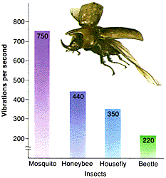
Bar Graph
Used for discrete categories
Used for comparison
EX. Number of books each class collects
EX. Number of pies each person eats at a contest
EX. Number of dogs that eat certain brands of dog food

Slide 13
Bar Graph
What would be an appropriate title for this graph?
How many insects were tested?
What was the dependent variable?
What was the investigator trying to find out in this experiment?

Slide 14
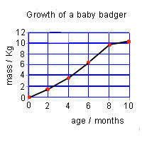
Line Graph
Continuous data
Shows change over time
EX: A student’s grades as study time increases
EX: Temperature of water as it is heated or cooled
EX: Shoe size as a child ages

Slide 15
Line Graph
What is the title of this graph?
What is the independent variable?
What unit is mass measured in?
How long did this experiment take?
What did the baby badger weigh when it was 6 months old?

Slide 16
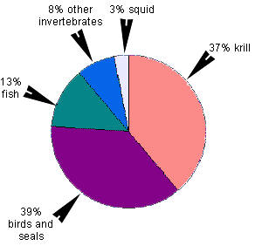
Circle Graphs
Show how parts relate to a whole
Percentages
EX: Music preferences of students in a class
EX: Voting preferences of a certain population
EX: Percentages of teachers with various levels of degrees

Slide 17
Circle Graphs
What would be an appropriate title for this graph?
Which item do leopard seals eat the most often?
Which item do leopard seals eat the least often?
All of the items should add up to _____%.

Slide 18
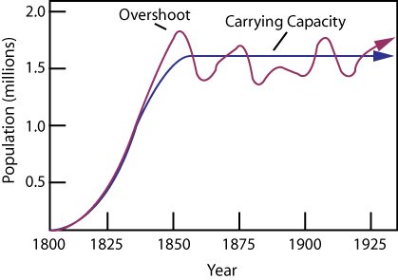
Which Graph Should Be Used?
You want to show the number of organisms living in a certain area over the period of 125 years.
Line Graph—change over time

Slide 19
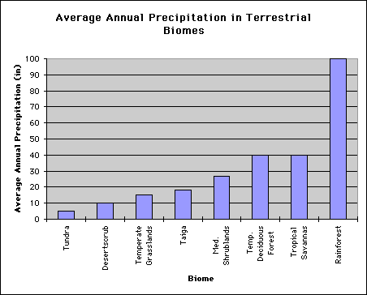
Which Graph Should Be Used?
You want to compare the amount of precipitation that is found in the different biomes.
Bar Graph—comparison

Slide 20
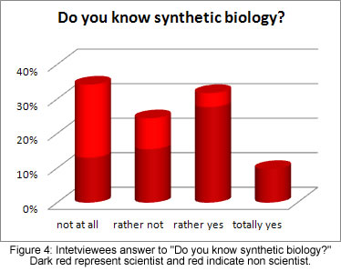
Which Graph Should Be Used?
You conduct a survey and want to show the number of people that chose not at all, rather not, rather yes and totally yes.
Bar Graph—comparison

Slide 21
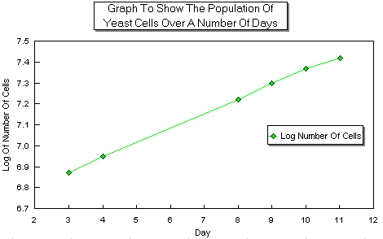
Which Graph Should Be Used?
You want to show the population of yeast cells as they grow and divide over a period of 12 days.
Line Graph—change over time

Slide 22
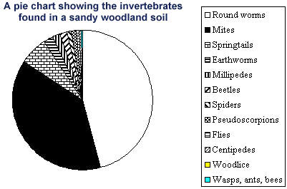
Which Graph Should Be Used?
You want to show how the numbers of different insect categories compare to the whole.
Circle Graph—parts compared to whole

